Slide 1
The Importance of Pelvic Floor Exercises in the Menopause
Nadine Ranger
Senior Pelvic Health Physiotherapist

Slide 2

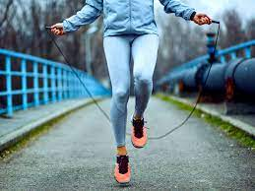
Reasons for Pelvic Floor weakness/dysfunction
Pregnancy and Childbirth
Chronic Constipation
Heavy or Repeated Lifting
High Impact Exercise
Elevated BMI
Chronic respiratory conditions
Smoking
Menopause
Neurological conditions /Diabetes

Slide 3
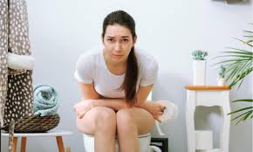
Symptoms of Pelvic Floor dysfunction
Stress urinary incontinence
Frequency and urgency/urge
Heaviness/Dragging feeling in the vagina
Pain during intercourse
Constipation

Slide 4
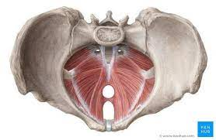
What is the Pelvic Floor?
Muscular floor of the Pelvis made of 3 layers
Five important roles-
Organ support
Stability
Sphincteric function
Sexual function
Circulation

Slide 5
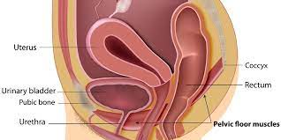
How do I perform Pelvic
Floor Exercises ( Kegels)?
In a comfortable lying or seated position, imagine that you are trying to stop yourself passing wind and urine at the same time and draw the muscles upwards and forwards from the back passage to the bladder
Long and short squeezes
Aim x10 of both x 3/day

Slide 6
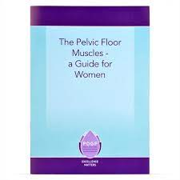

Useful Resources
https://www.youtube.com/watch?v=OA4ql0NbeUI- Trust pelvic floor video
NHS Squeezy App
POGP Pelvic Floor Muscle Booklet
Self referral to Physiotherapy

Slide 7

